Slide 1





WELCOME TO OUR FIRST WORKSHOP IN:
AWS CLOUD CLUB - PUP MANILA
DEPARTMENT IN ﻿
MACHINE LEARNING / ARTIFICIAL INTELLIGENCE

Slide 2



Now let's move on to some libraries commonly used in Data processes and Machine learning.
But, before that,
What's a library?

Slide 3
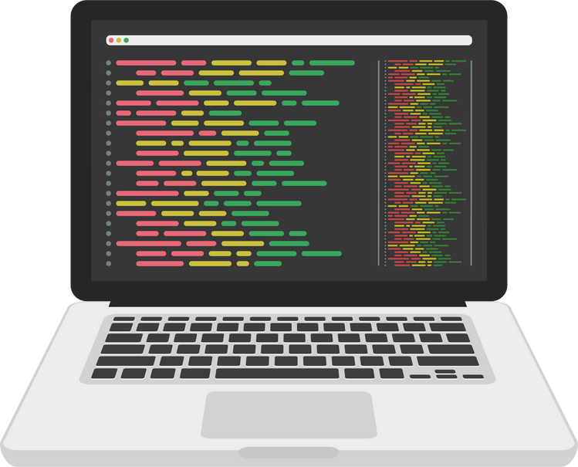

Libraries:
01
A library is a collection of codes that developers have created, or in other words, "pre-written codes" that we can reuse to solve a problem. So imagine it like a toolbox, which makes your life easier building things in your code.
02
It can contain lots of functions, such as a function to add two numbers like what we declared above.
03
It can also contain classes, which is a blueprint for creating something like a "Person" where it can contain methods (or functions) like eating, walking, breathing, as well as attributes (or variables) like height, weight, and age.

Slide 4

Now, let's get into it by starting with "NumPy"

Slide 5



What’s Numpy?
NumPy, short for Numerical Python, is a package or a library that can deal with numerical computations, which can speed things up for you if you want to solve mathematical problems, like dealing with arrays of numbers, matrices, or anything that involves huge amount of numbers. In other words, NumPy arrays can perform complex mathematical operations on VERRYY big data more efficiently and with less code than Python's built-in lists, which is why many developers like Machine Learning engineers are in love with NumPy.

Slide 6
Advantages of NumPy over normal Python Lists:
01
Efficient memory usage because NumPy arrays store elements of the same data type, whereas Python lists can contain elements of different data types. And because NumPy arrays store data in a contiguous (in adjacent) block of memory.
02
It can integrate well with other libraries and tools used in Data processing and Machine learning ecosystem, such as Pandas, Matplotlib, and scikit-learn.
03
It allows you to easily do arethmetic operations with every element in an array (also known as element-wise operations), which makes it easy and very fast to do maths with the entire array because it uses something called "vectorized operations".

